Slide 1
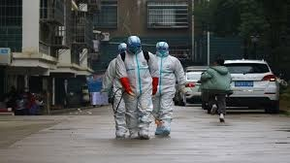

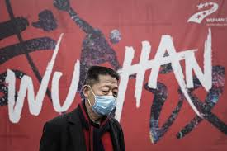
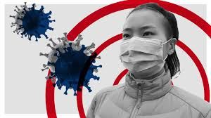
2019-nCoV
Clinical Management and IPC
Professor Quazi Tarikul Islam
Professor of Medicine, Popular Medical College

Slide 2
CONTENTS
Surveillance Case definition
Triage: recognize and sort patients with SARI
Early supportive therapy and monitoring
Management of hypoxemic respiratory failure and acute respiratory distress syndrome (ARDS)
Management of septic shock
Prevention of complications
Specific anti-nCoV treatments
Special considerations for pregnant patients, Immunocompromised
Immediate implementation of appropriate infection prevention and control (IPC) measures

Slide 4
Transmission
Most commonly spread from an infected person to others through the air by coughing and sneezing
Close personal contact, such as touching or shaking hands
Touching an object or surface with the virus on it, then touching your mouth, nose, or eyes before washing your hands
Rarely, fecal contamination

Slide 5
Surveillance Case definition
Suspect case
A. Patients with severe acute respiratory infection (fever, cough, and requiring admission to hospital) AND
with no other etiology that fully explains the clinical presentation
AND at least one of the following:
• a history of travel to or residence in the city of Wuhan, Hubei Province, China in the 14 days prior to symptom onset, or
• patient is a health care worker who has been working in an environment where severe acute respiratory infections of unknown etiology are being cared for.

Slide 6
B. Patients with any acute respiratory illness AND at least one of the following:
• close contact with a confirmed or probable case of 2019-nCoV in the 14 days prior to illness onset, or
• visiting or working in a live animal market in Wuhan, Hubei Province, China in the 14 days prior to symptom onset, or
• worked or attended a health care facility in the 14 days prior to onset of symptoms where patients with hospital-associated 2019-nCov infections have been reported.

Slide 7
Probable case
A suspect case for whom testing for 2019nCoV is inconclusive or for whom testing was positive on a pan-coronavirus assay.
Confirmed case
A person with laboratory confirmation of 2019-nCoV infection, irrespective of clinical signs and symptoms

Slide 8
Symptoms and Complications

Slide 9
Reported illnesses have ranged from infected people with little to no symptoms to people being severely ill and dying.
Incubation period: From 2 days or as long as 14 days after exposure.
Symptoms can include:
Fever
Cough
Shortness of breath

Slide 10
Uncomplicated illness
Uncomplicated upper respiratory tract viral infection, may have
non-specific symptoms such as
fever, cough, sore throat, nasal congestion, headache, muscle pain or malaise.
The elderly and immunosuppressed may present with atypical symptoms. These patients do not have any signs of dehydration, sepsis or shortness of breath.

Slide 11
According to and article published in The Lancet on 24 January 2020, the following clinical features were observed among confirmed cases:
https://doi.org/10.1016/S0140-6736(20)30183-5

Slide 12
Timeline of 2019-nCoV cases after onset of illness

Slide 13
Number of hospital admissions by age group.
https://doi.org/10.1016/S0140-6736(20)30183-5

Slide 14
Clinical syndromes associated with2019- nCoV infection
Uncomplicated illness
Mild Pneumonia
Severe Pneumonia
Acute Respiratory Distress Syndrome
Sepsis
Septic shock

Slide 15
Mild pneumonia
Patient with pneumonia and no signs of severe pneumonia.

Slide 16
Definitions of patients with SARI, suspected of nCoV
An ARI with history of fever or measured temperature ≥38 C° and cough; onset within the last ~10 days; and requiring hospitalization.
Absence of fever does NOT exclude viral infection.

Slide 17
Severe pneumonia
a. Adolescent or adult: fever or suspected respiratory infection, plus at least
one of
respiratory rate >30 breaths/min,
severe respiratory distress,
SpO2 <90% on room air.
b. Child with cough or difficulty in breathing, plus at least one of the following:
central cyanosis or SpO2 <90%;
severe respiratory distress
signs of pneumonia with a general danger sign: inability to breastfeed or drink, lethargy or unconsciousness, or convulsions.
chest indrawing, fast breathing

Slide 18
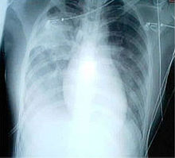
SEVERE ACUTE PNEUMONIA

Slide 19
ARDS
Onset within 1 week of a known clinical insult, or new or
worsening respiratory symptoms
• Bilateral opacities on chest X-ray, not fully explained by effusions, lobar/lung collapse or nodules
• Respiratory failure not fully explained by cardiac failure or fluid overload. Objective assessment (e.g. by echocardiography) must exclude hydrostatic oedema if no risk factor is present

Slide 20
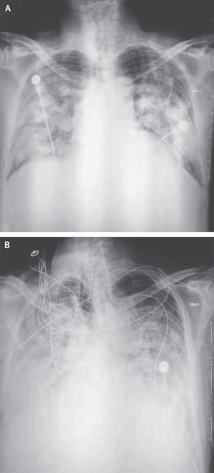
ARDS

Slide 21
Sepsis
Adults: life-threatening organ dysfunction caused by a dysregulated host response to suspected or proven infection, with organ dysfunction.
Septic shock
Adults: persisting hypotension despite volume resuscitation, requiring vasopressors to maintain MAP ≥65 mmHg and serum lactate level >2 mmol/L.

Slide 22
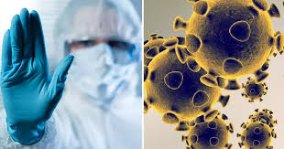
Management

Slide 23
Home care for patients with suspected novel coronavirus

Slide 24
For mild symptoms case:
Ideally they should be hospitalized as there is lack of information of outcome in these cases. Can be kept at home
Avoid direct contact with body fluids
Place the patient in a well-ventilated single room.
• Limit the number of caretakers of the patient
Household members should stay in a different room or, if that is not possible, maintain a distance of at least 1 m from the ill person
• Limit the movement of the patient and minimize shared space.
• The caregiver should wear a medical mask fitted tightly to the face when in the same room with the ill person.

Slide 25
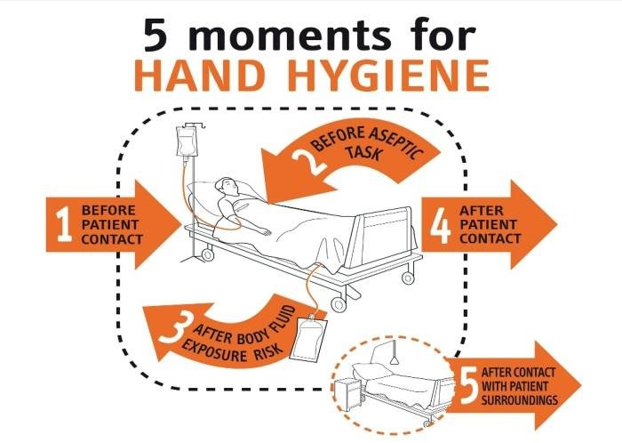
Perform hand hygiene following all contact with ill persons or their immediate environment

Slide 26
Management of contacts
In view of the limited evidence of human-to-human transmission of 2019-nCoV, persons (including health care workers) who may have been exposed to individuals with suspected 2019-nCoV infection should be advised to monitor their health for 14 days from the last day of possible contact and seek immediate medical attention if they develop any symptoms.

Slide 27
Early supportive therapy and monitoring

Slide 28
Headlines
Supplemental oxygen therapy
Conservative fluid management
Empiric antimicrobials
Closely monitor patients with SARI
Understand the patient’s co-morbid condition
Do not routinely give systemic corticosteroids

Slide 29
Give supplemental oxygen therapy immediately to patients with SARI and respiratory distress, hypoxaemia, or shock.
Initiate oxygen therapy at 5 L/min and titrate flow rates to reach target SpO2 ≥90% in non-pregnant adults and SpO2 ≥92-95 % in pregnant patients.
Children with emergency signs should receive oxygen therapy during resuscitation to target SpO2 ≥94%; otherwise, the target SpO2 is ≥90%.
All areas where patients with SARI are cared for should be equipped with pulse oximeters, functioning

Slide 30
Fluid Therapy
Patients with SARI should be treated cautiously with fluids.
Aggressive Fluid therapy may worsen the patients

Slide 31
Give empiric antimicrobials to treat all likely pathogens causing SARI
Give antimicrobials within one hour of initial patient assessment for patients with sepsis.
Empiric antibiotic treatment should be based on the clinical diagnosis local epidemiology and susceptibility data, and treatment guidelines.
Empiric therapy includes a neuraminidase inhibitor for treatment of influenza when there is local circulation or other risk factors, including travel history or exposure to animal influenza viruses.
Empiric therapy should be de-escalated on the basis of microbiology results and clinical judgment.

Slide 32
Collection of specimens for laboratory diagnosis for follow up

Slide 33
In hospitalized patients with confirmed nCoV infection, repeat URT and LRT samples should be collected to demonstrate viral clearance at least every 2 to 4 days until there are two consecutive negative results.

Slide 34
Management of hypoxemic respiratory failure and ARDS

Slide 35
Recognize when patient with respiratory distress is failing standard oxygen therapy.
Should be managed in ICU setting with defined protocol.
High-flow nasal oxygen (HFNO) or non-invasive ventilation (NIV) should only be used in selected patients with hypoxemic respiratory failure.
Endotracheal intubation should be performed by a trained and experienced provider using airborne precautions.

Slide 36
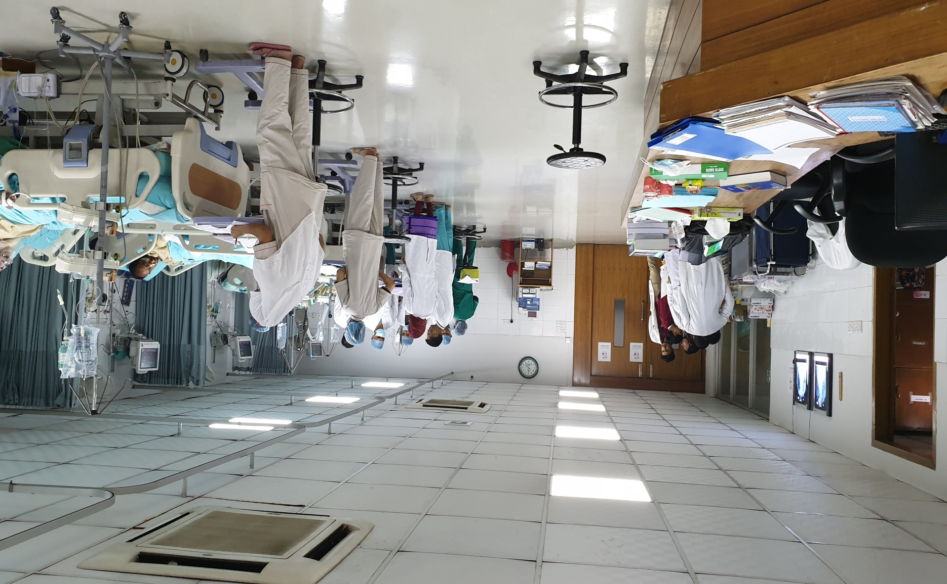

Slide 37
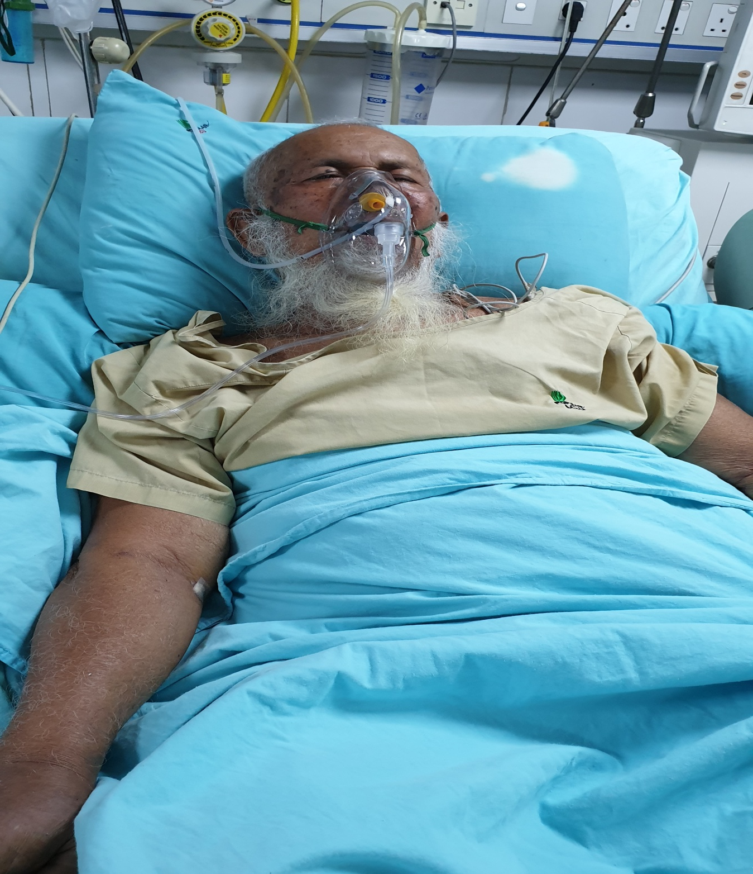

Slide 38
Management of septic shock

Slide 39
The patient should be managed according to sepsis protocol
Recognize septic shock in adults when infection is suspected or confirmed AND vasopressors are needed to maintain mean arterial pressure (MAP) ≥65 mmHg AND lactate is ≥2 mmol/L, in absence of hypovolemia.
In resuscitation from septic shock in adults, give at least 30 ml/kg of isotonic crystalloid in adults in the first 3 hours.
Do not use hypotonic crystalloids, starches, or gelatins for resuscitation.
Avoid Volume overload

Slide 40
Administer vasopressors when shock persists during or after fluid resuscitation. The initial blood pressure target is MAP ≥65 mmHg in adults and age-appropriate targets in children.
If signs of poor perfusion and cardiac dysfunction persist despite achieving MAP target with fluids and vasopressors, consider an inotrope such as dobutamine.

Slide 41
Prevention of complications

Slide 42
Reduce days of invasive mechanical ventilation Reduce incidence of ventilator associated Pneumonia (VAP) Reduce incidence of venous thromboembolism | Use weaning protocols new ventilator circuit for each patient low molecular-weight heparin
Reduce incidence of catheter related bloodstream infection | remove catheter if no longer needed
Reduce incidence of pressure ulcers | Turn patient every two hours
Reduce incidence of stress ulcers and gastrointestinal bleeding | early enteral nutrition , PPI

Slide 43
Specific anti-Novel-CoV treatments and clinical research

Slide 44
There is no current evidence from RCTs to recommend any specific anti-nCoV treatment for patients with suspected or confirmed nCoV.
No specific treatment is currently available, Existing anti-virals are being studied. This includes:
Protease inhibitors
indinavir, saquinavir, remdesivir, lopinavir/ritonavir and interferon beta.
Neuraminidase inhibitors: Osaltamevir

Slide 45
Special considerations for pregnant patients and Immunocompromised
Pregnant women with suspected or confirmed nCoV should be treated with supportive therapies , taking into account the physiologic adaptations of pregnancy.
Emergency delivery and pregnancy termination decisions are challenging and based on many factors: gestational age, maternal condition, and fetal stability. Consultations with obstetric, neonatal, and intensive care specialists are essential.
Immunocompromised patients needs extra care and attention

Slide 46
Implementation of appropriate IPC measures

Slide 47

Prevention

Slide 48
How to protect yourself
There are currently no vaccines available to protect you against human coronavirus infection.
You may be able to reduce your risk of infection by doing the following:
Wash your hands often with soap and water for at least 20 seconds
Avoid touching your eyes, nose, or mouth with unwashed hands
Avoid close contact with people who are sick

Slide 49
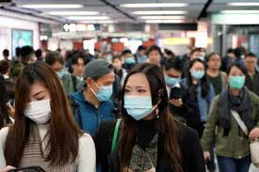
How to protect others
If you have cold-like symptoms, you can help protect others by doing the following
Stay home while you are sick
Avoid close contact with others
Cover your mouth and nose with a tissue when you cough or sneeze, then throw the tissue in the trash and wash your hands
Clean and disinfect objects and surfaces

Slide 50
The basic principles to reduce the general risk of transmission of acute respiratory infections:
• Avoiding close contact with people suffering from acute respiratory infections.
• Frequent hand-washing, especially after direct contact with ill people or their environment.
• Avoiding unprotected contact with farm or wild animals.
• People with symptoms of acute respiratory infection should practice cough etiquette (maintain distance, cover coughs and sneezes with disposable tissues or clothing, and wash hands).

Slide 51
• Within healthcare facilities, enhance standard infection prevention and control practices in hospitals, especially in emergency departments.
• WHO does not recommend any specific health measures for travelers.
In case of symptoms suggestive of respiratory illness either during or after travel, the travelers are encouraged to seek medical attention and share their travel history with their health care provider.

Slide 52
IPC (infection prevention and control measures) is a critical and integral part of clinical management of patients and should be initiated at the point of entry of the patient to hospital.
Standard precautions include hand hygiene; use of PPE to avoid direct contact with patients’ blood, body fluids, secretions (including respiratory secretions) and non-intact skin.
Standard precautions also include prevention of needle-stick or sharps injury; safe waste management; cleaning and disinfection of equipment; and cleaning of the environment.

Slide 53
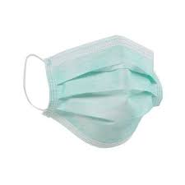
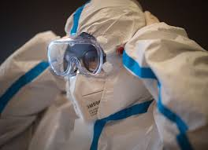
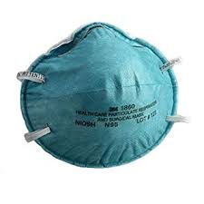
Medical Mask
Proper PPE
N 95 mask

Slide 54
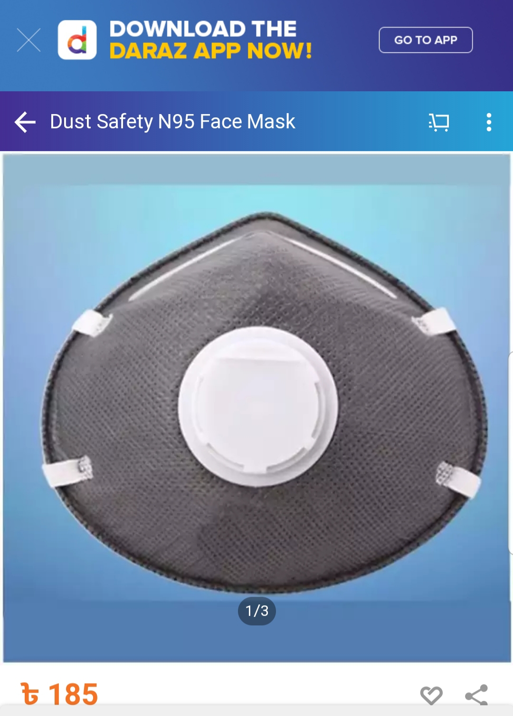

Slide 55
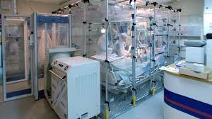
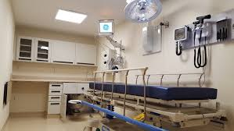
Isolation unit

Slide 56
Vaccine Research
In January 2020, based on the 2019-nCoV published genome,[several projects, three supported by the Coalition for Epidemic Preparedness Innovations (CEPI), began work on creating a vaccine for the Wuhan coronavirus.
The United States National Institutes of Health (NIH) started cooperating with the biotechnology company Moderna to create a vaccine, hoping to start production by May 2020. Their strategy is to make an RNA vaccine matching a spike of the coronavirus surface.
The University of Queensland (UQ; Australia) aims for a molecular clamp vaccine that genetically modifies viral proteins to make them mimic the coronavirus and stimulate an immune reaction. CEPI supports the Moderna and UQ projects and another by Inovio.
Public Health Agency of Canada granted (Canada) permission to Vaccine and Infectious Disease Organization – International Vaccine Centre (VIDO-InterVac) of the University of Saskatchewan VIDO-InterVac aims to start production and non-human animal testing in March 2020, and human testing in 2021.

Slide 57
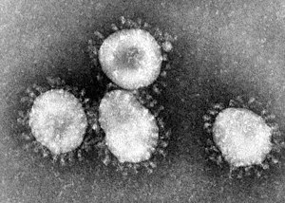

Slide 58
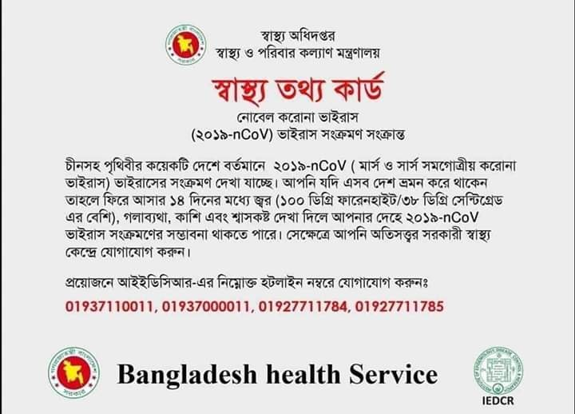

Slide 59


